Slide 1

Non Functional aspects of web
Aruna S
Department of
Computer Science and Engineering

Slide 2

Non functional aspects of web
HTTP 2.0
S. Aruna
Department of Computer Science and Engineering

Slide 3
HTTP 2.0
Introduction
HTTP/2 is a major revision of the HTTP network protocol used by the World Wide Web.
It was derived from the earlier experimental SPDY protocol, originally developed by Google.
HTTP/2 was developed by the HTTP Working Group of the Internet Engineering Task Force.
What is HTTP/2?
In 2015, Internet Engineering Task Force (IETF) release HTTP/2, the second major version of the most useful internet protocol, HTTP.
It was derived from the earlier experimental SPDY protocol.

Slide 4
HTTP 2.0
Main goals of developing HTTP/2
Protocol negotiation mechanism — protocol electing, eg. HTTP/1.1, HTTP/2 or other.
High-level compatibility with HTTP/1.1 — methods, status codes, URIs and header fields.
Page load speed improvements trough:
Compression of request headers
Binary protocol
HTTP/2 Server Push
Request multiplexing over a single TCP connection
Request pipelining
HOL blocking (Head-of-line) — Package blocking

Slide 5
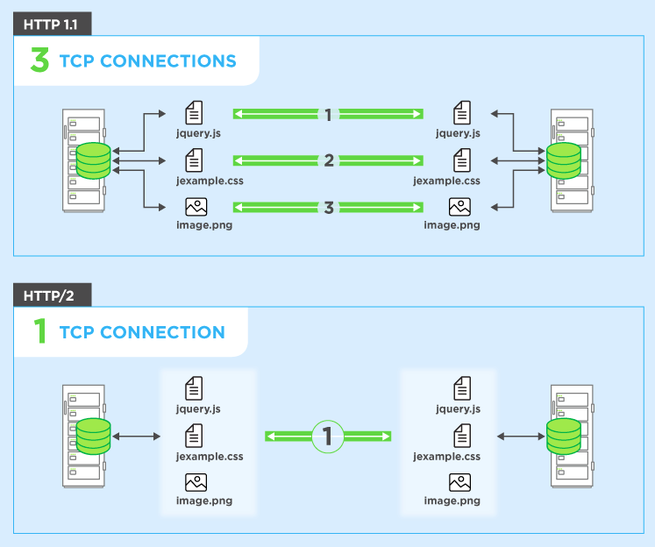
HTTP 2.0
Request Multiplexing
HTTP/2 can send multiple requests for data in parallel over a single TCP connection.
This is the most advanced feature of the HTTP/2 protocol because it allows you to download web files asynchronously from one server.

Slide 6
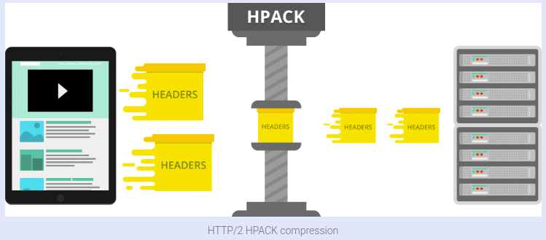
HTTP 2.0
Header Compression
HTTP/2 compress a large number of redundant header frames. It uses the HPACK specification as a simple and secure approach to header compression.
HPACK compresses the individual value of each header before it is transferred to the server, which then looks up the encoded information in a list of previously transferred header values to reconstruct the full header information.

Slide 7
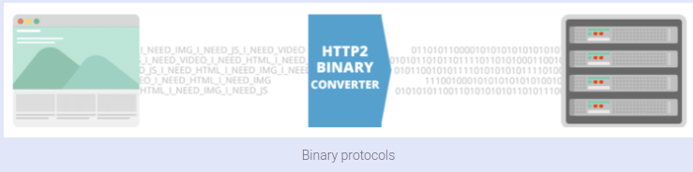
HTTP 2.0
Binary Protocol
HTTP1.x used to process text commands to complete request-response cycles. HTTP/2 will use binary commands (in 1s and 0s) to execute the same tasks.

Slide 8
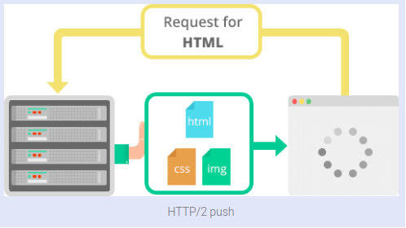
HTTP 2.0
Server Push
server to send additional cacheable information to the client that isn’t requested but is anticipated in future requests.

Slide 9
THANK YOU
Aruna S
Department of
Computer Science and Engineering
arunas@pes.edu

